Slide 1
An Introduction to Database
Introduction to Database for Undergraduate Study
Lecture 10
Example – Work Out
This lecture and its associated materials have been produced by Mr. Rohit Panday (M.Sc. IT, 10+ Years of Industry/Academic Experience) of iAcademy for the purposes of lecturing on the above described subject and the material should be viewed in this context. The work does not constitute professional advice and no warranties are made regarding the information presented. The Author and iAcademy do not accept any liability for the consequences of any action taken as a result of the work or any recommendations made or inferred. Permission to use any of these materials must be first granted by iAcademy.

Slide 2

Database Design
Database Design is a very crucial and important process of System Design and Development.
Usually requires experience to excel in database design

Slide 3
Basic Process (Relational Model)
Textual Analysis
Identification of Entities
Formation of Entity Relationship Diagram
Identification of Relationship and Cardinality
Filling of Attributes

Slide 4
Example
Let us assume, a college runs multiple modules. Students take modules during course of study. College keeps record about id, name, address, telephone number and dob of Students while module details like module Code, Name, Detail of Course and Year of Study is provided to students.
It is essential to keep record of dates of enrollment for each module students take.

Slide 5
Step 1: Textual Analysis
Let us assume, a college runs multiple courses. Students take courses during course of study. College keeps record about id, name, address, telephone number and dob of Students while course details like Course Code, Name, Detail of Course and Year of Study is provided to students.
It is essential to keep record of dates of enrollment for each courses students take.

Slide 6
Step 2: Identification of Entities
Let us assume, a college runs multiple courses. Students take courses during course of study. College keeps record about id, name, address, telephone number and dob of Students while course details like Course Code, Name, Detail of Course and Year of Study is provided to students.
It is essential to keep record of dates of enrollment for each courses students take.
Possible Entities
Student
Course

Slide 7
Step 3: Identification of Relationships
take
STUDENT
MODULE
One Student can take many Modules
One Module can be taken by Many Students

Slide 8
Step 3: Identification of Relationships
ID
Code
Name
Name
take
Address
STUDENT
MODULE
Detail
Tel
DoB
EnrollDate
Year

Slide 9
Step 4: Identification of Constraints
ID
Code
Name
Name
take
Address
STUDENT
MODULE
Detail
Tel
DoB
EnrollDate
Year

Slide 10
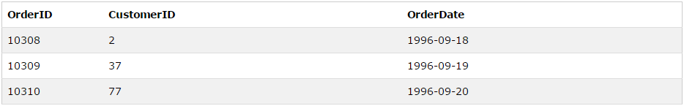
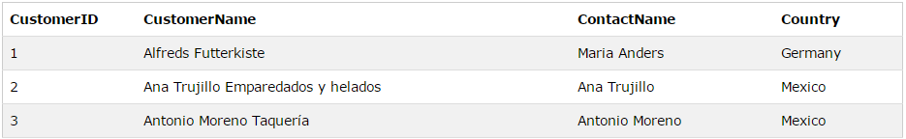
Example Tables
Order Table
Customer Table
How can I get Name of Customers with OrderID and OrderDate ?

Slide 11
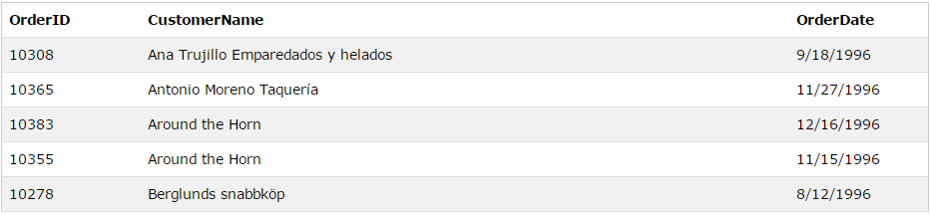
Inner Join
Example | SELECT Orders.OrderID, Customers.CustomerName, Orders.OrderDate FROM Orders INNER JOIN Customers ON Orders.CustomerID=Customers.CustomerID;
Meaning
The "CustomerID" column in the "Orders" table refers to the "CustomerID" in the "Customers" table. The relationship between the two tables above is the "CustomerID" column.

Slide 12
Inner Join - Syntax
Syntax | SELECT column_name(s) FROM table1 INNER JOIN table2 ON table1.column_name=table2.column_name;
Syntax | SELECT column_name(s) FROM table1 JOIN table2 ON table1.column_name=table2.column_name;

Slide 13
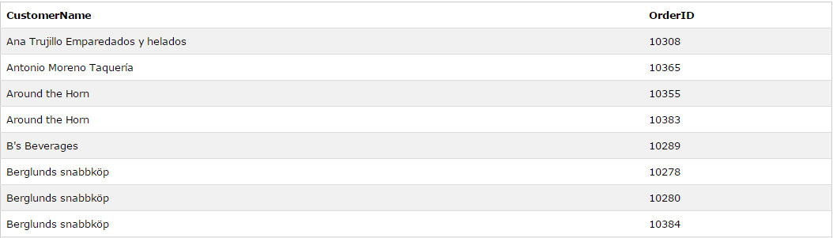
Inner Join - Demo
Example | SELECT Customers.CustomerName, Orders.OrderID FROM Customers INNER JOIN Orders ON Customers.CustomerID=Orders.CustomerID ORDER BY Customers.CustomerName;
Image

Slide 14
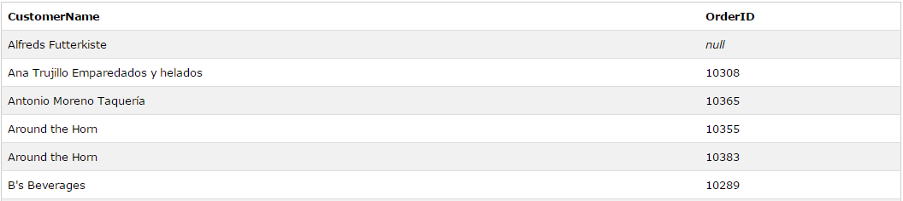
Left Join - Demo
Example | SELECT column_name(s) FROM table1 LEFT JOIN table2 ON table1.column_name=table2.column_name;

Slide 15
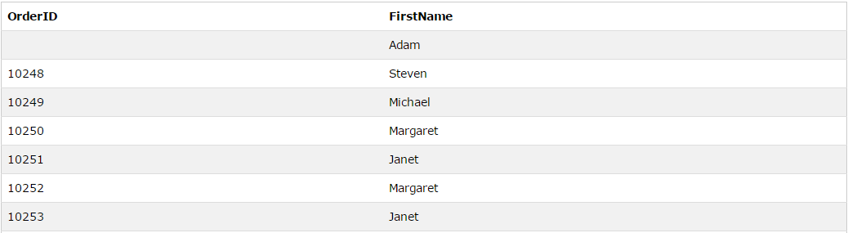
Right Join - Demo
Example | SELECT column_name(s) FROM table1 RIGHT JOIN table2 ON table1.column_name=table2.column_name;

Slide 16
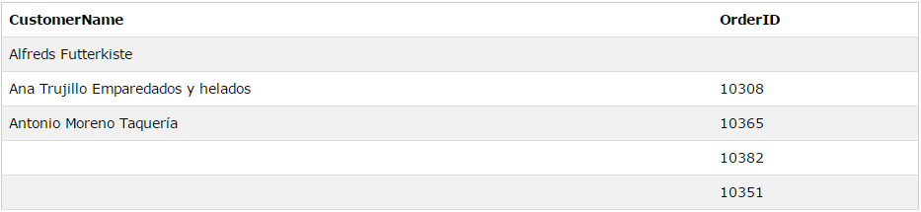
Full Join - Demo
Example | SELECT column_name(s) FROM table1 FULL OUTER JOIN table2 ON table1.column_name=table2.column_name;

Slide 17

Self Join - Demo
Example | SELECT G1.gid, G1.first_name, G1.last_name, G2.gid, G2.first_name, G2.last_name FROM Gardners G1 INNER JOIN Gardners G2 ON G1.first_name = G2.first_name

Slide 18
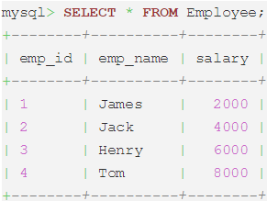
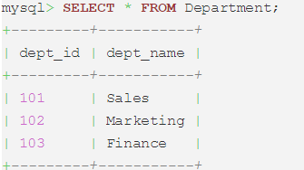
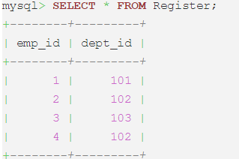
Joining Three Tables

Slide 19
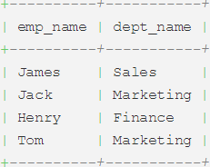
Joining Three Tables
SELECT emp_name, dept_name FROM Employee e JOIN Register r ON e.emp_id=r.emp_id JOIN Department d ON r.dept_id=d.dept_id;

Slide 20
GROUP BY Clause
Aggregate Function
Uses multiple rows as input and returns single row as output
Grouping
Used to group the columns with similar values

Slide 21
Group By Clause
Syntax | SELECT column_name, aggregate_function(column_name) FROM table_namecWHERE column_name operator valuecGROUP BY column_name;
Result | The GROUP BY statement is used in conjunction with the aggregate functions to group the result-set by one or more columns.

Slide 22
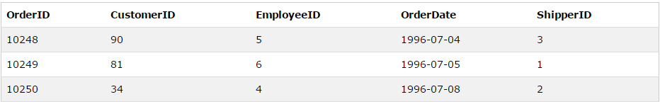
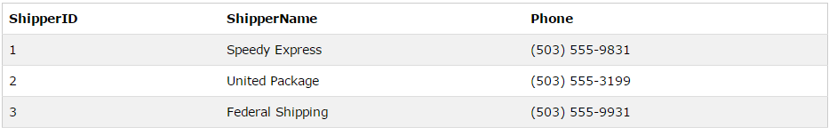
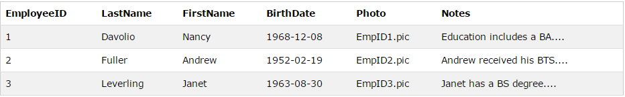
Group By Clause

Slide 23
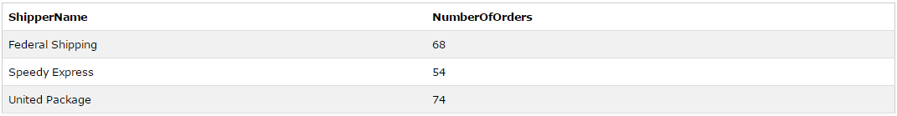
Group By Clause
Syntax | SELECT Shippers.ShipperName,COUNT(Orders.OrderID) AS NumberOfOrders FROM Orders LEFT JOIN Shippers ON Orders.ShipperID=Shippers.ShipperID GROUP BY ShipperName;
Result

Slide 24
HAVING Clause
Syntax | SELECT column_name, aggregate_function(column_name) FROM table_name WHERE column_name operator value GROUP BY column_name HAVING aggregate_function(column_name) operator value;
Result | The HAVING clause was added to SQL because the WHERE keyword could not be used with aggregate functions.

Slide 25
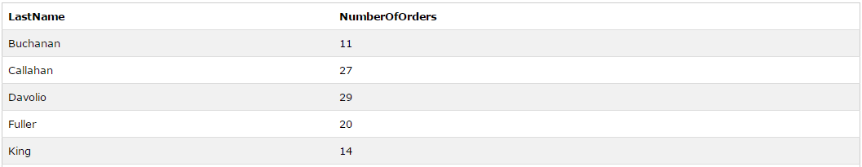
HAVING Clause
Syntax | SELECT Employees.LastName, COUNT(Orders.OrderID) AS NumberOfOrders FROM (Orders INNER JOIN Employees ON Orders.EmployeeID=Employees.EmployeeID) GROUP BY LastName HAVING COUNT(Orders.OrderID) > 10;
Result

Slide 26
Key Points

Slide 27
Laugh

Slide 28

End of Lecture for Week - 10

